Slide 1
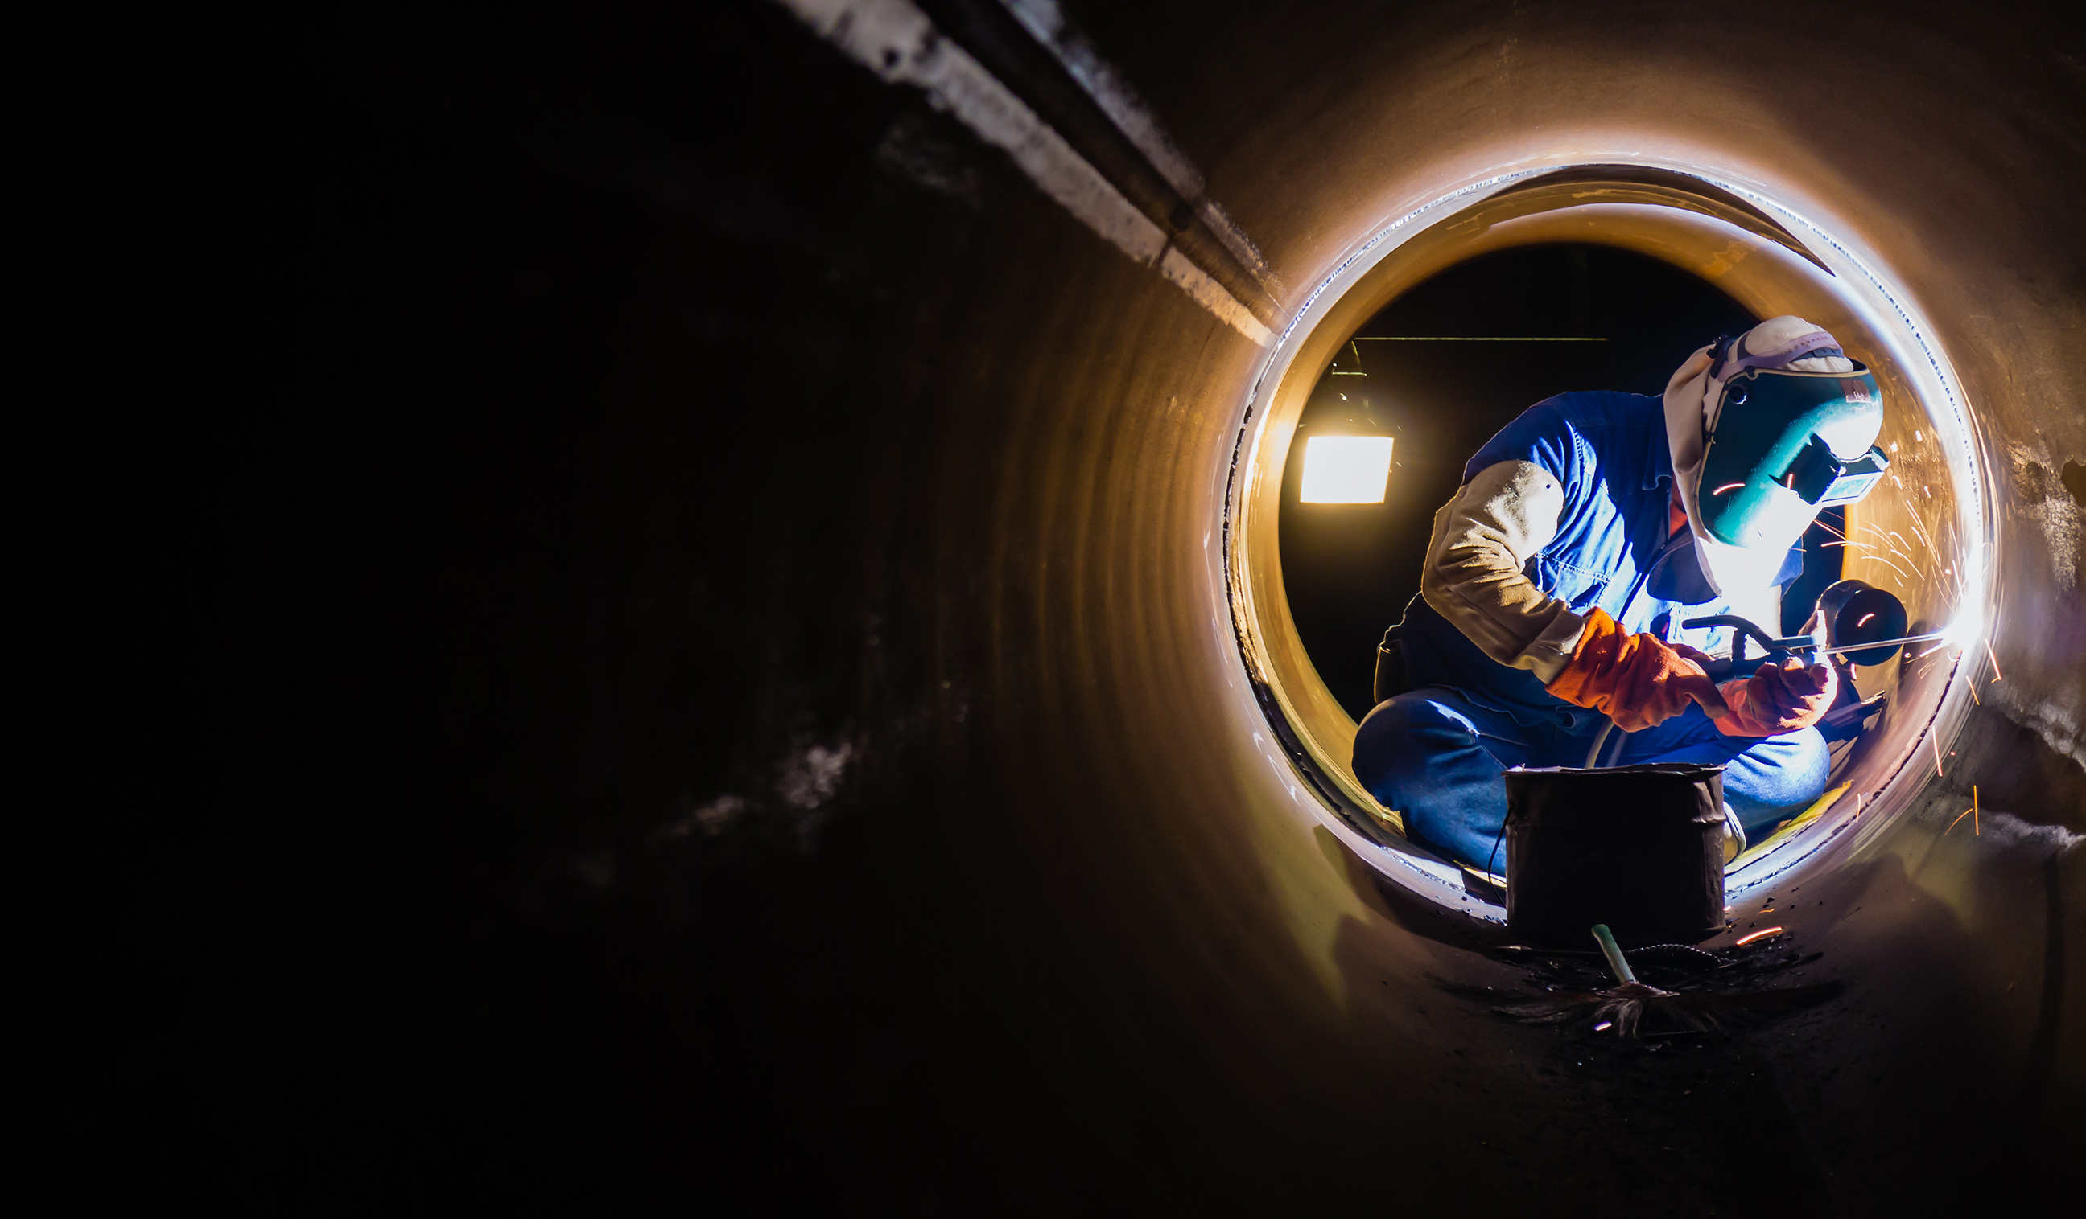


VIRTUAL REALITY WELDING TRAINING
CODED WELDER: OFO 651202-02
KM-02: General health, safety and environmental protection, NQF Level 2, 1 Credit

Slide 2
ABOUT THIS MODULE
The focus of this module is to introduce welding safe work practices in an industrial environment.
The learning will enable learners to demonstrate an understanding of:
KM-02-KT01: general health, safety and environmental protection concepts (30%)
KM-02-KT02: welding specific health, safety and environmental protection concepts (70%)

Slide 3
KM-02-KT01: General health, safety and environmental protection concepts
In welding, ensuring the health and safety of workers while protecting the environment is paramount.
Key concepts encompass personal protective gear, fire and electrical safety, proper waste management, and adherence to regulatory standards.
By implementing these principles, industries can foster a safer and more environmentally responsible welding environment.

Slide 4
General overview of occupational health and safety legislation
The tools and machinery used in this occupation, are dangerous, understanding safety guidelines for tools and machinery is vital.
Industrial accidents often result from unsafe actions (88%), unsafe working conditions (10%) and unforeseen accidents (2%).
Laws like the Occupational Health and Safety Act of 1993 and the Minerals Act of 1991 prioritize workplace safety.
Coded Welders should also know these regulations:
Driven Machinery Regulations, 1988-2015
SANS 10085-1:2004 - Scaffold guidelines
Pressure Equipment Regulations: 2009

Slide 5
General workshop safety rules and practices
Negligence and lack of accident prevention knowledge leads to many accidents.
Developing safe working habits promptly is essential.
Preventing accidents involves taking responsibility and prioritizing the well-being of oneself and colleagues.
A professional attitude toward the job and workplace is crucial.

Slide 6
Safety measures to help develop safe working habits.
-Use protective footwear to prevent foot injuries.
Secure sleeves to avoid entanglement.
Protect your eyes with safety glasses when using machinery.
Wear a hard safety hat near overhead cranes.
Gloves for sharp objects and hazardous liquids.
Keep your area clean and use gloves for cleanup.
Ensure ventilation with flammable substances.

Slide 7
Safety measures to help develop safe working habits (p2):
No smoking to prevent fires.
Keep a clean workspace and use scrap bins.
Inspect and report faulty electrical equipment.
Maintain accessible fire-fighting gear, check expiration dates and seals.
Know the first-aid kit's location.
Avoid running or playing games in the workshop.

Slide 8
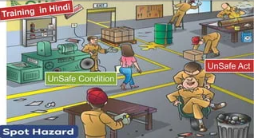
Let's discuss possible unsafe conditions in the picture:

Slide 9

Welding involves joining metals using heat and filler material.
Hand and power tools are essential for welding's precision, efficiency, and safety.
These tools include welding torches, grinders, clamps, and protective gear.
Mastery of these tools is crucial for welding excellence.
*(Discussed in detail in KM-03)*

Slide 10
Safety measures to be considered when using hand tools
Use tools for their intended purposes.
Point sharp edges away from yourself and towards the workbench.
Keep tools clean, dry, and oil-free.
Store and maintain tools properly.
Avoid carrying sharp-edged tools in pockets.
Keep a clutter-free work area to prevent accidents.
Use tools correctly and responsibly.

Slide 11
Safety measures when using power tools
Perform a quick risk assessment of your work area.
Know how to operate the power tool and stop it in emergencies.
Work within designated areas in the fabrication shop.
Store power tools and accessories properly.
Ensure the job is securely clamped before grinding.
Use a protective screen during grinding to redirect sparks away from colleagues.

Slide 12
Welding environmental protection and pollution
In South Africa, environmental legislation is rooted in the Constitution (No. 108 of 1996), specifically in Chapter 2's Bill of Rights.
Section 24 of the Constitution grants everyone the right to:
An environment that doesn't harm their health or well-being.
Environmental protection through reasonable legislative measures to:
Prevent pollution and ecological degradation.
Promote conservation.
Ensure ecologically sustainable development and the justifiable balance of economic and social development for present and future generations.

Slide 13
Chapter 2 (environmental legislation ) of the Constitution includes various rights:
Right to information
Right to freedom of expression -
Right to participate in political activity
Right to administrative justice
Fundamental rights in science, culture, law, economy, and the environment
Legislatures must enable public participation in policy processes.
Citizens have the ongoing right to engage in public initiatives and processes.

Slide 14
Impact of environmental laws on the engineering environment.
The welding environment adhere to the environmental laws in the following ways:
Maintain a tidy work environment with good housekeeping practices.
Prevent pollution by ensuring proper ventilation and gas extraction.
Implement fire prevention measures in the workshop.
Promote recycling practices whenever feasible.

Slide 15
Hazard identification and risk assessment principles
Hazardous substances are defined by health effects on people, while dangerous goods are defined by physical and chemical properties in a work environment.
Hazardous substances encompass dust, fibers, gases, vapors, smoke, fumes, and chemical substances.
Workplace risks involve exposure to high dust levels without a respirator, loud noise without hearing protection, heavy manual lifting, and strenuous work in hot conditions.
In workplaces, there are four main types of hazards: physical hazards, chemical hazards, biological hazards, and psychosocial hazards.

Slide 16
Carrying out a hazard risk assessment
Step 1. Identifying hazards and those at risk
Step 2. Evaluating and prioritising risks
Step 3. Deciding on preventive action
Step 4. Taking action
Step 5. Monitoring and reviewing

Slide 17
Safety signs and color coding
Symbolic safety signs are represented by the South African Bureau of Standards (SABS) in the SABS 1186 standard.
The categories of safety which we should be mostly aware are the following:
Firefighting (red signs)
General information (green signs)
Safety warnings (yellow triangular signs)
General safety protection (blue signs)
Prohibitions (“thou shalt nots”) – red circles with a line drawn across

Slide 18
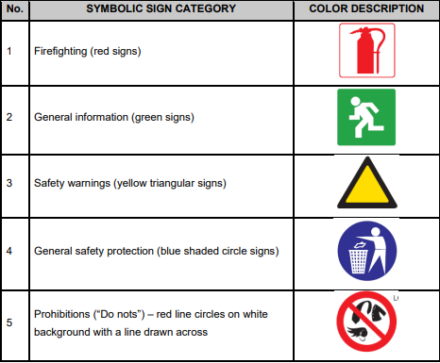
See the tables below for examples:

Slide 19
Color codes serve as a vital safety measure in workshops, machine shops, factories, and plants.
The National Occupational Safety Association (NOSA) has established specific color codes that must be understood and correctly applied.
These color codes are utilized to identify various safety features:
Hazardous machine parts
Fire-fighting equipment
Color-coded pipelines
Safe walkways
Danger zones

Slide 20
Color codes serve as a vital safety measure in workshops, machine shops, factories, and plants.
NOSA The National Occupational Safety Association (NOSA) has established specific color codes that must be understood and correctly applied.
These color codes are utilized to identify various safety features:
Hazardous machine parts
Fire-fighting equipment
Color-coded pipelines
Safe walkways
Danger zones

Slide 21
The most important safety features which students should know and their color codes:
Arctic Blue – Air
Jacaranda - Acids
Dove grey - Alkalis
Signal Red – Fire - Fighting
Yellow – Walkways
Brilliant green – Water
Light Stone – Gases (other than air)
Golden Brown - Oils
Silver or aluminum - Steam
Red and wine (Candy – Stripe tape)- Danger zones

Slide 22
Personal protective equipment (PPE)
Due to the inherent risks associated with the welding process.
It is essential for welders to safeguard against hazards such as arc radiation, respiratory risks, sparks, electric shock, and high temperatures.
PPE ensures workplace safety, compliance with regulations, and prevention of injuries.

Slide 23
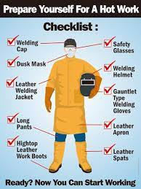
Protective clothing for Welders (PPE)

Slide 24
Fundamentals of securing the worksite
Good planning is important to project or construction site security
- Activities to improve site security:
Develop a site-specific security plan.
Assign security responsibilities and promote worker awareness.
Collaborate with local authorities and neighboring properties.
Regularly inventory and protect on-site assets.

Slide 25
Improving site security (p2)
Secure the site perimeter with proper fencing.
Safeguard materials, vehicles, and equipment.
Control site access through one monitored entry point.
Ensure adequate lighting for deterrence.
Encourage reporting of incidents by employees and subcontractors.
Consider security guards and video monitoring for site traffic.

Slide 26
Behavioural safety
Workers' behavior in engineering environments significantly impacts safety standards.
Here are rules of behavior to promote a safe environment:
Dress for the occasion
Vision Protection
Keep Your Workshop Clean
No Drugs, Alcohol Or Other Impairments Please!
Read the operating manual
Keep tools and equipment sharp
Avoid unnecessary distractions

Slide 27
Assessment Activity – KMO2-01
State the safety color code for each object.
Oil pipeline
Steam pipeline
Water pipeline
Walkways
Danger zones
Briefly describe five safety precautions regarding personal protection in the workplace?
Give six safety precautions when working with hand tools.
Give five safety precautions when working with power tools.

Slide 28
KT02 Welding specific health, safety and environmental protection concepts
Under this topic, students will be able to:
Explain the general hazards in a welding fabrication shop
Explain the need for ventilation, risks of explosion and handling of compressed gases
Explain basic safety precautions to be taken before and during welding (PPE, shielding, equipment, materials).

Slide 29
Welding safety risks
Welding operations present several hazards risks to both workers and nearby people.
Therefore, it’s important that you are aware of the risks and hazards welding poses and understand what precautions you can take to protect yourself.
Some examples of the hazards associated with welding include fumes and gases, hot materials and electrical risks (etc).

Slide 30
Exposure to Fumes and Gases – Safety risks
Welding exposes people to harmful fumes and gases.
Types of fumes include ozone, nitrogen oxides, chromium, nickel oxides, and carbon monoxide.
Harm depends on gas type, concentration, and exposure duration.
No safe limit, employers need to manage it.
Use control measures and respiratory protection.
Health risks include pneumonia, asthma, cancer, and metal fume fever.
Irritations like dry throat, tickling, coughing, and chest tightness may occur.

Slide 31
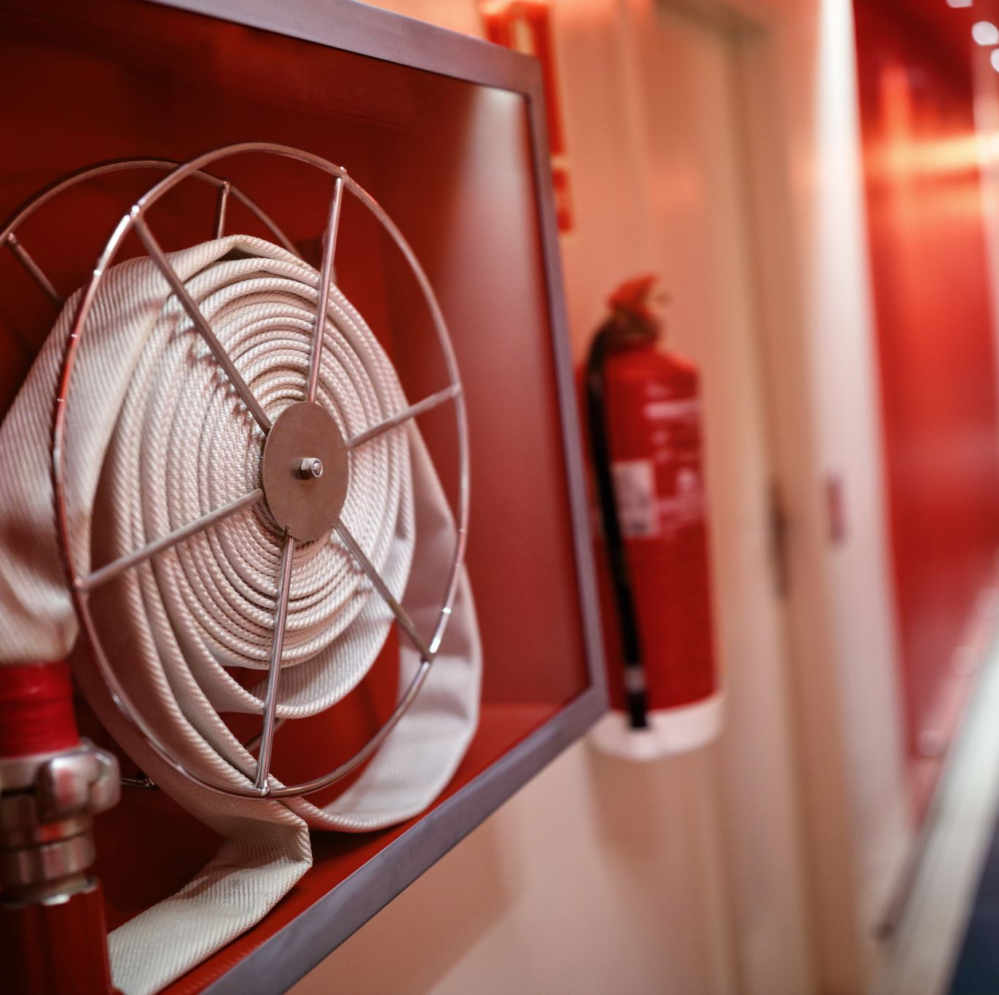
Fires and Explosions
Welding and hot work activities pose fire and explosion hazards.
Inadequate management can lead to severe consequences:
Serious or fatal injuries
Property damage

Slide 32
Electric Shock
Arc welding involves live electrical circuits, posing a risk of electric shock.
Electric shock is the most serious welding hazard and can cause severe injuries or fatalities.
It can result from direct shock or a fall from height after a shock.
Secondary electric shock is possible when touching the welding or electrode circuit simultaneously with the metal being welded.

Slide 33
Basic electric faults on welding machines
Insulation damage on power lead.
Faulty power lead connections.
Blocked air screens and outlets.
Malfunctioning switches.
Poor earthing.
Cracked or broken insulation.

Slide 34
Precautionary measures when working with electrical equipment
- Prevent accidental machine starts during repairs.
- Disconnect power and secure it for deliberate reconnection.
- Lock the switch 'Off' or use a padlock guard.
- Place warning signs for voltage.
- Mark AC or DC power.
- Use 'Danger' or 'Do not switch on' signs.
- Avoid using faulty portable electrical equipment.
- Maintain a record of monthly equipment checks.

Slide 35
Noise Hazards
Welding generates loud noises, sometimes exceeding 100 dB(A).
Prolonged exposure can cause permanent hearing loss.
Side effects include tinnitus, vertigo, increased heart rate, and blood pressure.

Slide 36
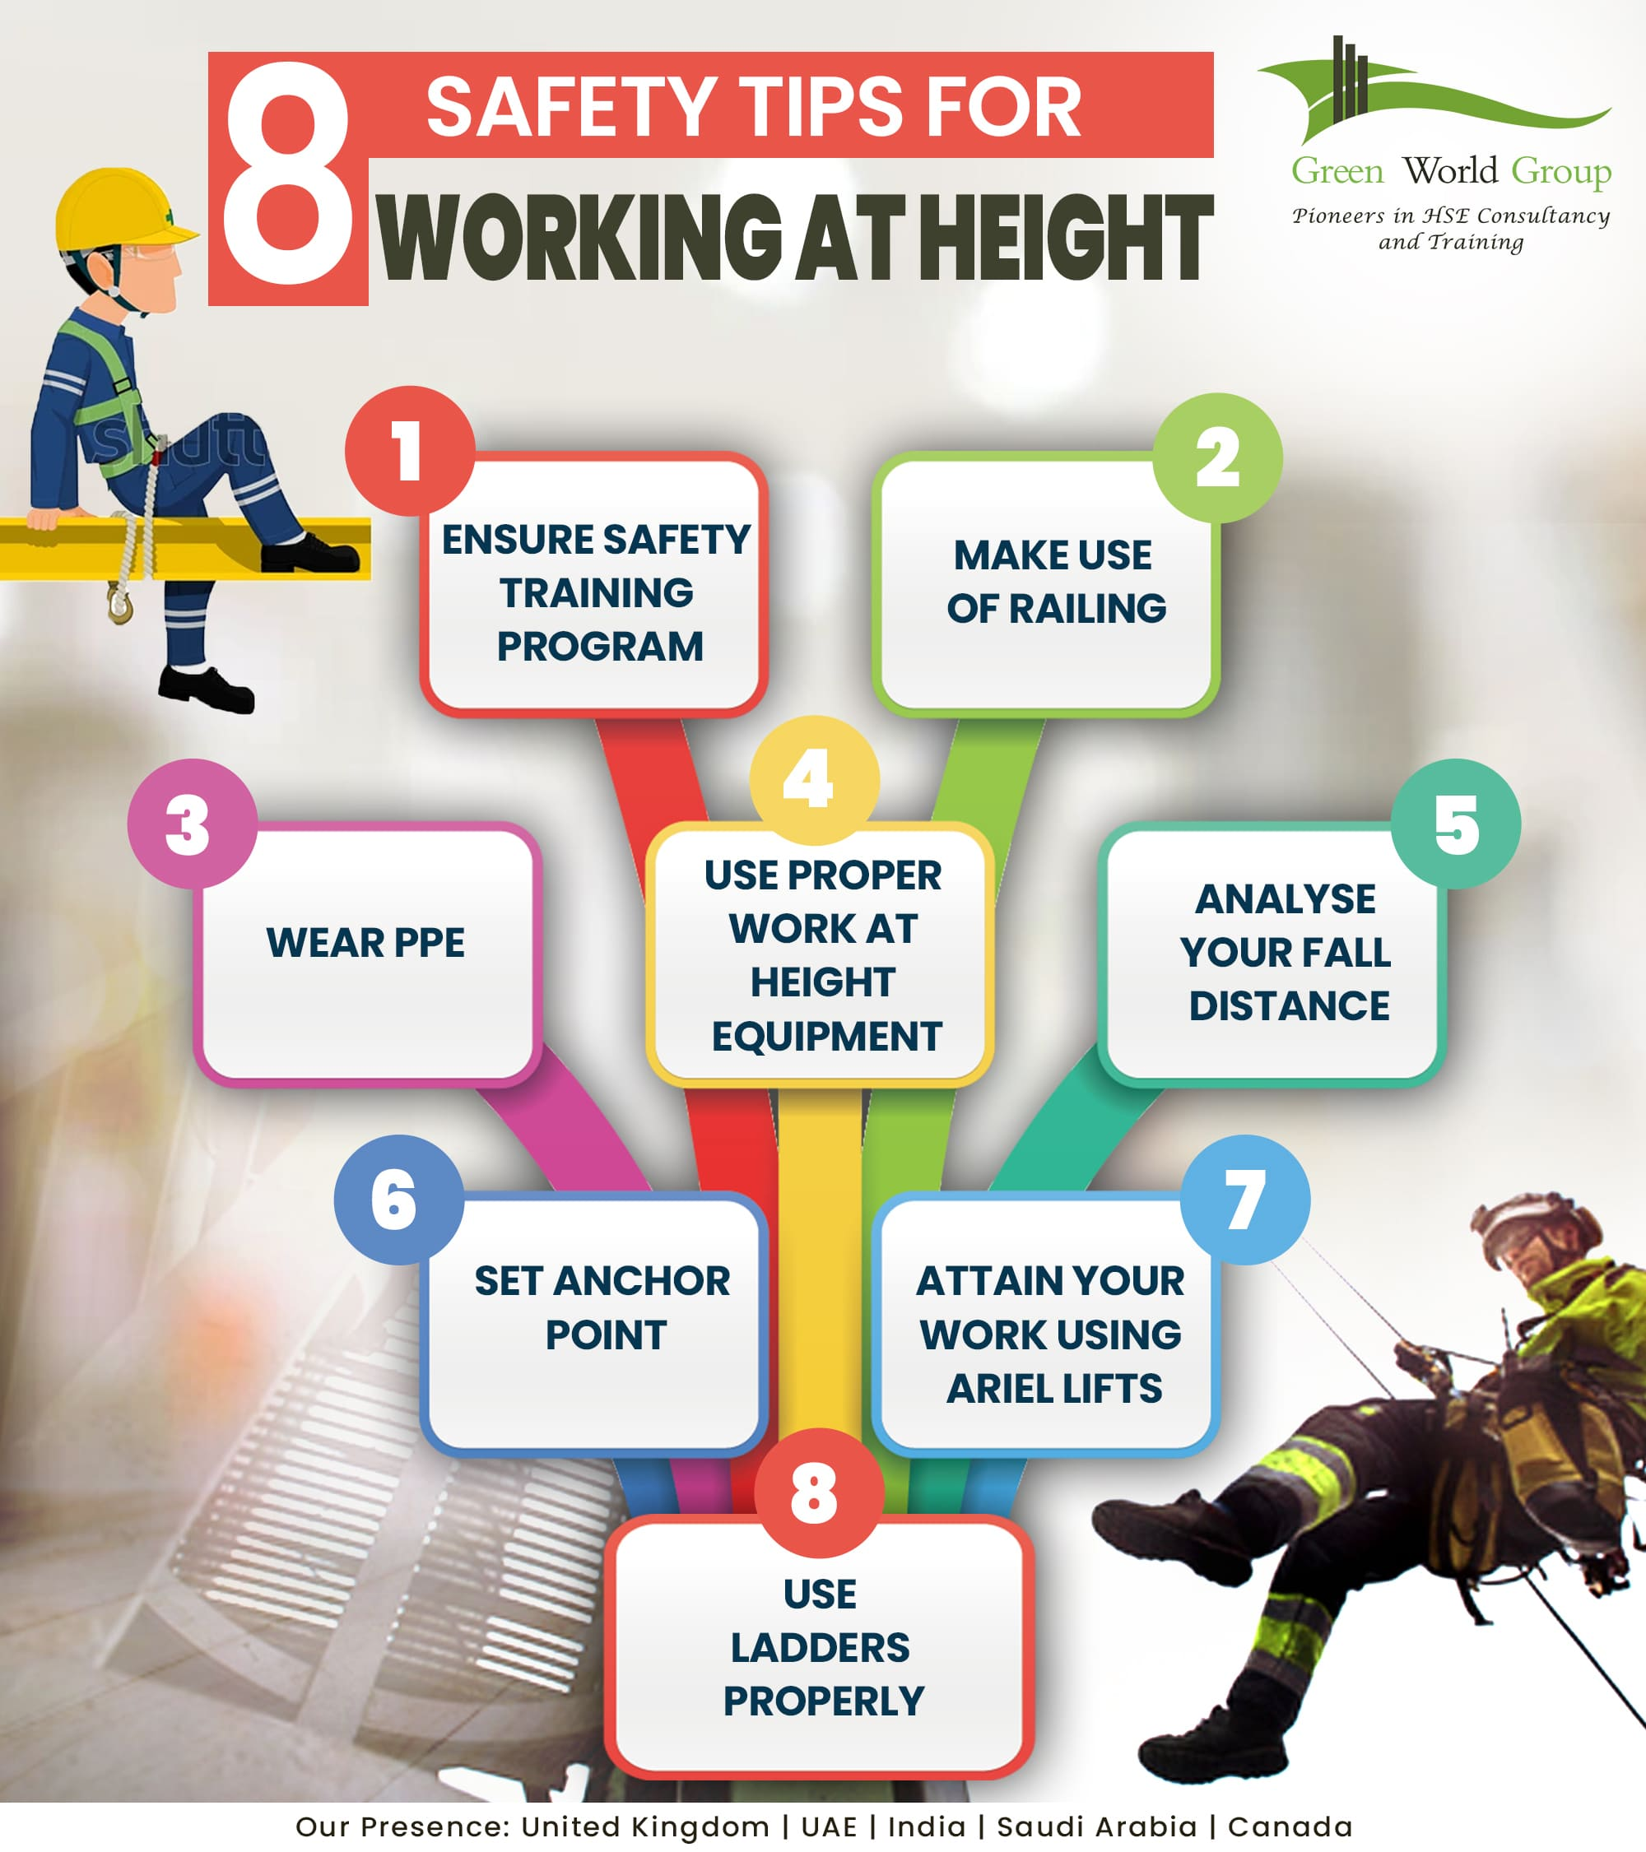
Working at heights
Working at height includes any situation where falling is possible.
Fall protection is required for changes in height of 4 feet or more.
Source: Green World Safety and Security Consultancies LLC

Slide 37
Minimum actions to be taken in a welding environment
Comprehensive training
Safe work practices
Risk assessment
PPE
Ventilation and fume extraction

Slide 38
Welding in confined spaces such as build-up of pollutants; risk of explosion; displacement of oxygen by gases like argon, nitrogen
Welding in confined spaces presents unique risks.
The welding process consumes oxygen and produces carbon monoxide.
When using fuel and inert gases in confined spaces, there's a risk of displacing oxygen, leading to unconsciousness or death.
Therefore, it's essential to implement rigorous safety measures when working in such confined areas.

Slide 39
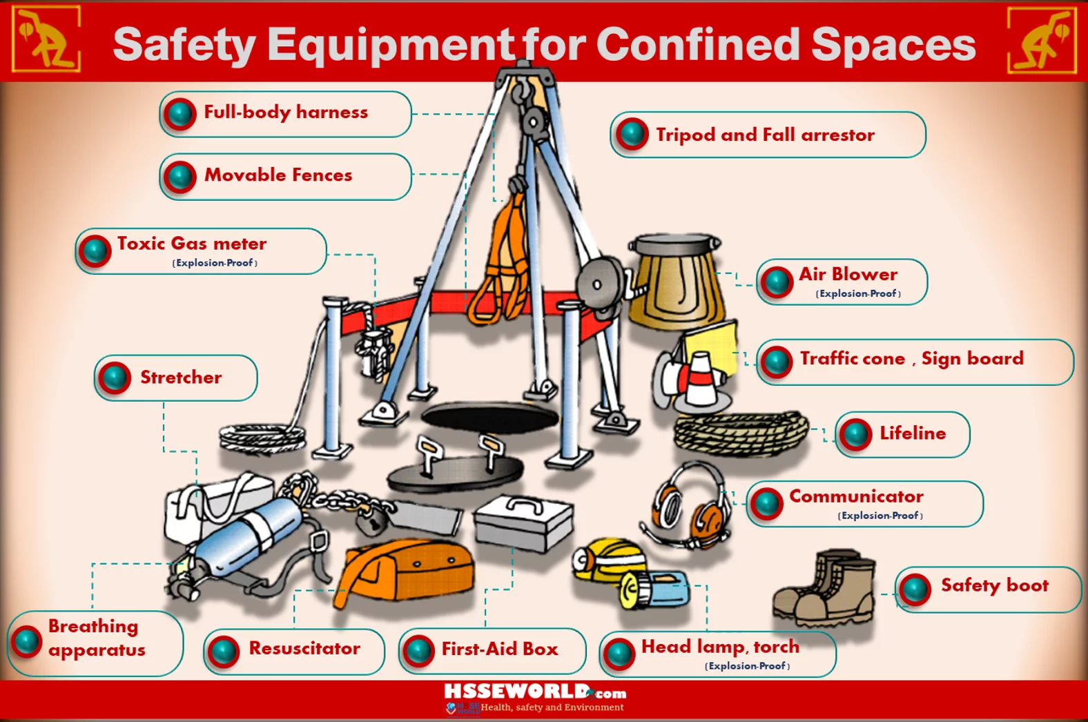
Source: Health, safety, security and Environment (HSSE)

Slide 40
Properties, handling and storage of compressed gases
Industrial gas cylinders conform to approved specifications.
Applies mainly to Southern African national suppliers like Afrox, Air Liquide, CADAC, BP, etc.
Valve outlets prevent interchange of fittings between flammable and non-flammable gases.
Only authorized agents can fill cylinders; never attempt to transfer gas between cylinders.
Do not alter cylinders, their color, valve threads, or markings in any way.

Slide 41
Marking, labelling, color coding and certificates – Gas cylinders
Gas cylinders must have permanent markings following national standards.
Tare mass is relevant when switching from permanent gas service to liquefiable gas service.
Pressure receptacles should not have their permanent markings removed, even when ownership changes.
Manufacturer's serial numbers should never be removed.
Approval by an Authorized Inspection Authority (AIA) and validation by a government-approved test facility are necessary.
Color coding is used to identify gas cylinders, with specific colors for different gases.
Changing a cylinder's service requires removing old paint before applying the new identification color.

Slide 42
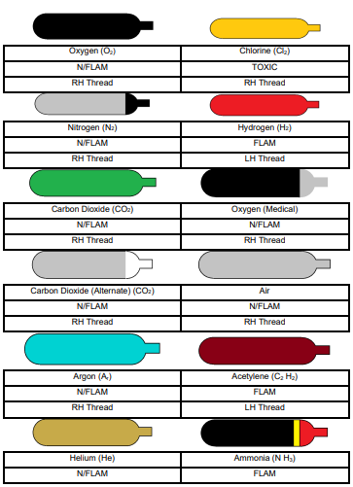
Industrial engineering & medical gases

Slide 43
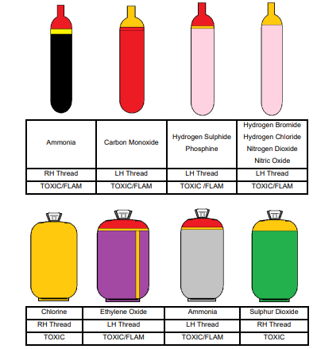
Special gases

Slide 44
All cylinder colors should be registered with the Liquefied Petroleum Gas Safety Association. White, grey, and aluminum.
Cylinders for medical gases must follow SANS 10006 for color markings.
Hazardous gas cylinder transport requires labeling.
For visible cylinders, "compressed gas" label not needed, but outer container should display it.
LPG cylinders under 20 liters need a safety pictogram label.
All cylinders should indicate use and direction, especially forklift fuel tanks.
Follow national legislation for extra labeling.

Slide 45
Handling, Storage, Transportation, and Use:
Handle gas cylinders with care to prevent shocks, sliding, or rolling.
Only stack cylinders designed for stacking, following rules for liquefied gas cylinders.
Securely wedge the ends of vertically stacked cylinders with clear gangways.
During transport, block and brace cylinders to avoid overhanging vehicle sides.
Special rules exist for LPG cylinder transport (SANS 10087-4).
Store cylinders with leaks or minor defects in well-ventilated areas; relocate leaking cylinders to open spaces if necessary.

Slide 46
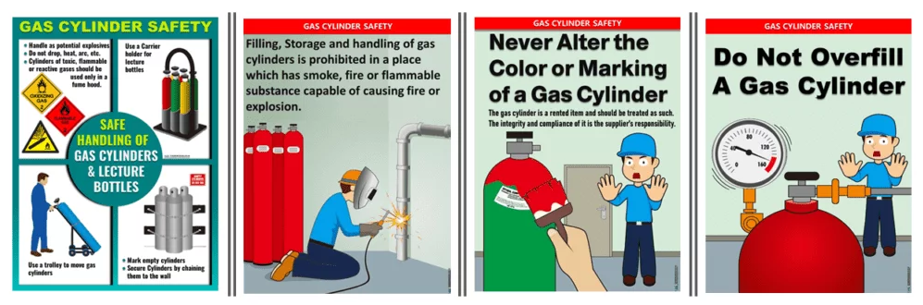
General Safety Precautions:

Slide 47
General Safety Precautions (p2)
Cylinders exposure to fires:
- Removed cylinders exposed to fire from service.
- Have them inspected following SANS 1825 requirements.
Position and Support of Gas Cylinders:
- Use liquefiable gas cylinders and those with dissolved acetylene in an upright position.
- Ensure they are stable and can't tip over.
- Secure horizontally used cylinders to prevent rolling.
Incident Reporting:
-Follow specified requirements for reporting incidents defined in national legislation.

Slide 48
Earthing arrangements of welding machines
Welding Machine Ground
Welding workpieces or workbenches should be grounded, typically to a metal building frame.
Double Insulated Welding Machines:
Some welding machines have double insulation and don't require a grounding conductor.
Workpiece Ground:
The workpiece or workbench must be grounded, as per ANSI Z49.1, to limit voltage in case of insulation failure.
Grounding the workpiece limits voltage in case of equipment insulation failure.
It's crucial for safety and electrical interference prevention.
The ground connection should be separate from the welding circuit connection.

Slide 49
Earthing arrangements of welding machines (p2)
Workpiece Connection vs. Ground Clamp:
Some welding machines use high-frequency circuits (e.g., TIG) that can interfere with nearby electronics.
Preventing Electrical Shocks:
Insulate welders from the welding circuit using dry insulating gloves and other means.
The workpiece connection is often mistakenly called a "ground clamp," but it's different from the actual ground connection.
Welding cable does not provide ground; the ground connection is separate.
High-Frequency Ground:
Proper grounding helps minimize interference.
Maintain insulation on weld cables, electrode holders, guns, and torches.
Prevent electric shock from the electrical supply system through proper equipment maintenance and extension cord care.

Slide 50
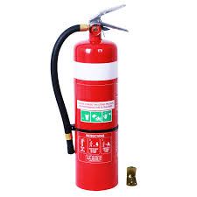
Extinguishing substances and fire fighting
Keep firefighting equipment ready for immediate use in case of a fire.
Water buckets and liquid-filled extinguishers may not be suitable near electrical welding without non-conductive footwear.
Welders should know different types of firefighting equipment and choose the right one for the situation.

Slide 51
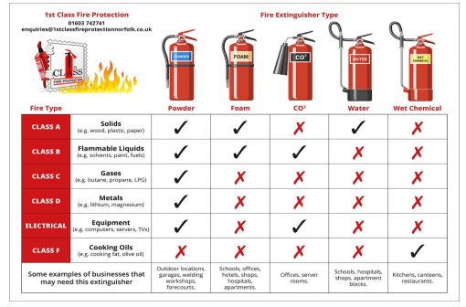
Types of fire extinguisher

Slide 52
General Safety Precautions (p2):
Before welding, inspect the work area for flammable substances and obtain approval from a responsible person or ensure their removal or protection.
In the absence of fire extinguishers, have access to firefighting equipment like hoses, sand buckets, or fire-resistant blankets.
When welding near flammable materials within 10 meters, use a fire watcher to monitor sparks and be prepared to extinguish any fires.

Slide 53

The End

